Slide 1
DECH
An E-Commerce platform developed using Django Python framework and MySQL database

Slide 2
Team
Vishishta Agrawal (161500626)
Prateek Pandey (161500404)
Yash Jalan (161500638)
Nikhil Pandey (161500356)
Namrata Tiwari (161500342)

Slide 3
Content
-> Introduction
-> Languages & tools
-> Software Description
-> Features

Slide 4
What is DECH ?
-> DECH is an e-commerce website.
-> It facilitates the user to purchase things without going to store.
-> It will address the shopping related problem.
-> It manages all the details about product , product type , price, orders.
-> It facilitates the user to compare the products.

Slide 5
Languages
&
Tools
Languages :
-> Django
-> HTML
-> MySQL
Tools :
-> PyCharm

Slide 6
Software Description
Django :
It is a python based free and open source web framework which follows the model view template architectural pattern
HTML :
Hyper Text Markup Language is the standard markup language for creating web pages and web application.

Slide 7
Software Description
MySQL :
It is the open source relational database management system. The server works in client/server or embedded system.
PyCharm :
It is an integrated development environment used in computer programming especially for python language.

Slide 8
Features
-> Provide shopping cart facility.
-> Allow multiple Payment methods.
-> Provide Customer Support.
-> Admin manages the detail of the product .
-> Provide search option by category name.
-> Provide filter option to search the required products.

Slide 9
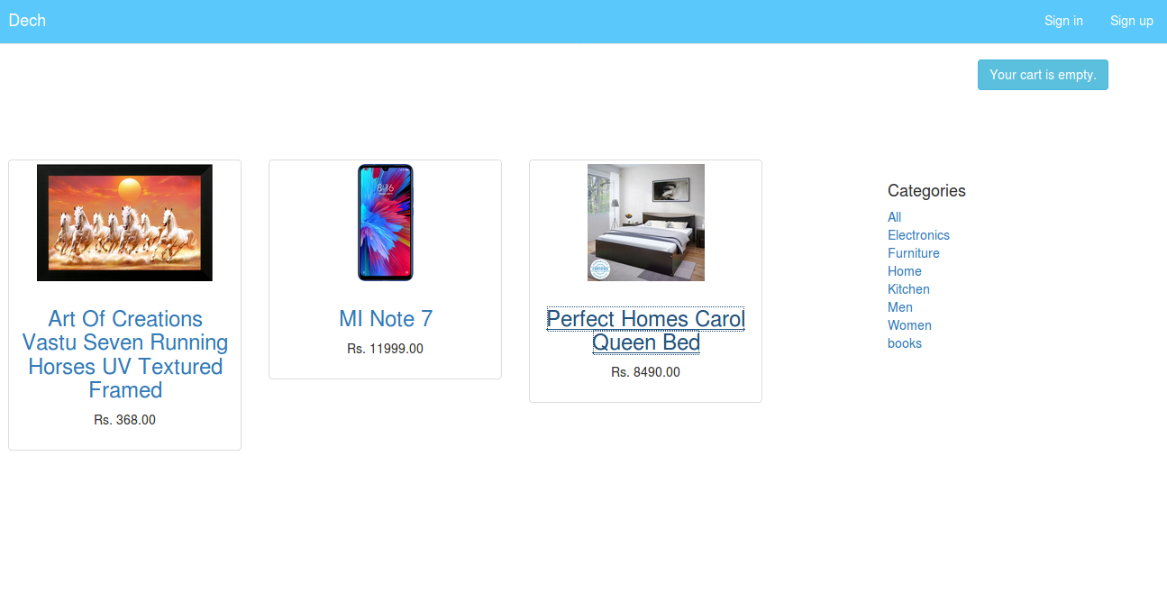
HOMEPAGE

Slide 10
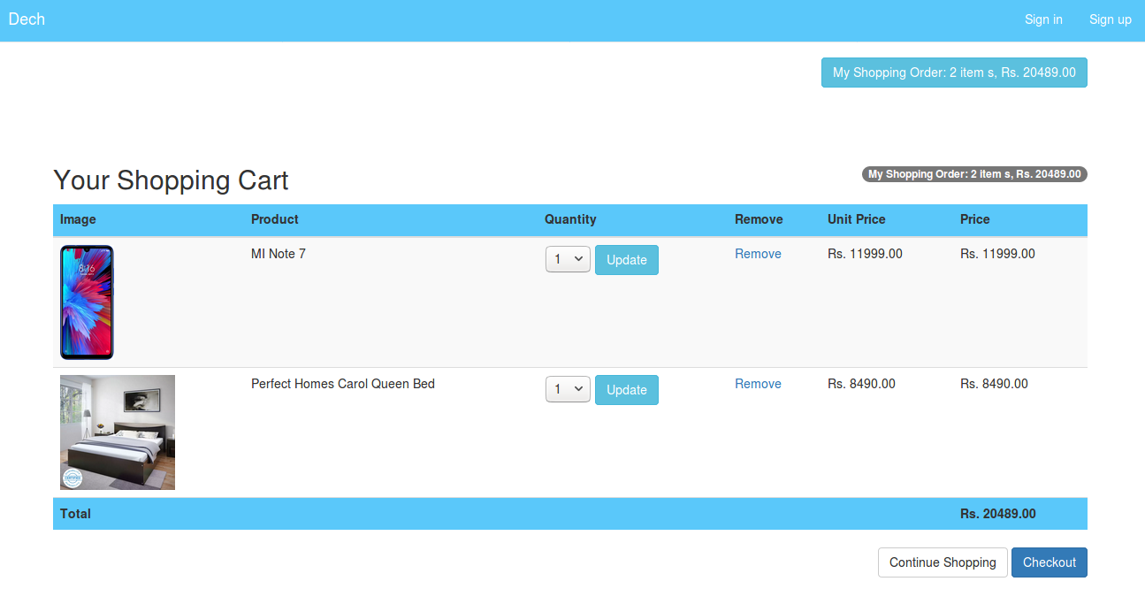
CART PAGE

Slide 11
Thank you

